Slide 1

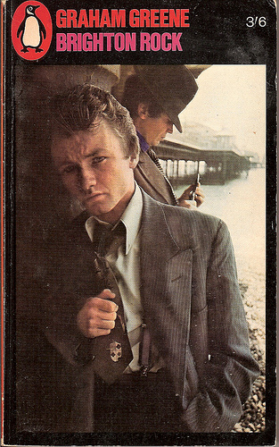
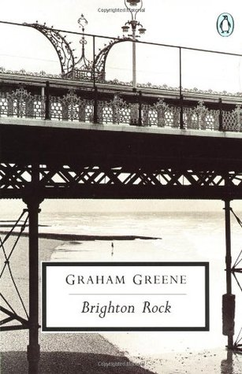
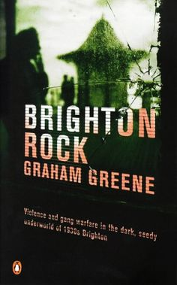
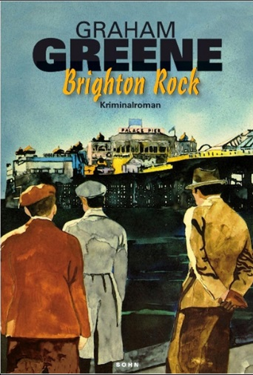
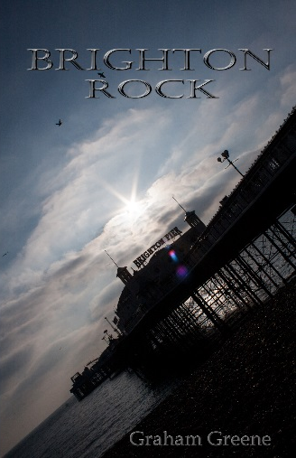

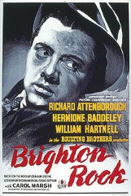
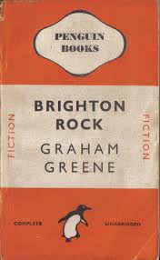


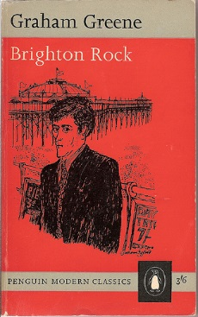
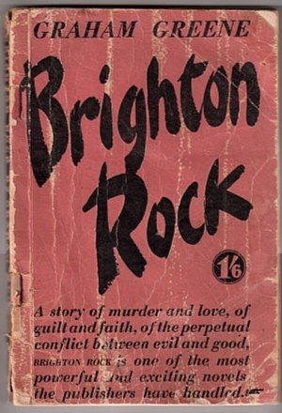
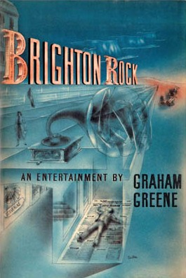
English Language – Paper 1
Brighton Rock

Slide 2
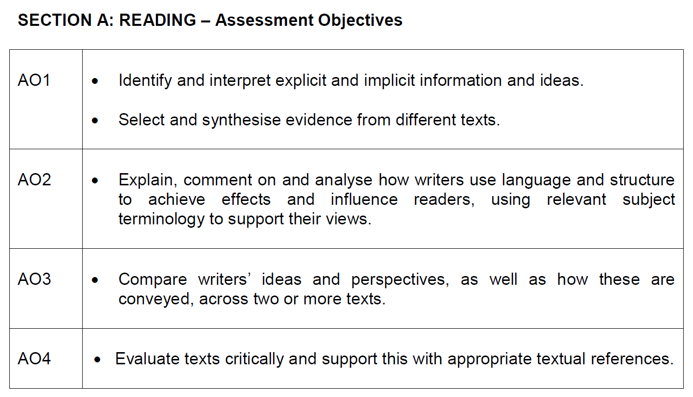

Slide 3
SECTION A: READING | MARKS | MINS
Read the questions and annotate source | 0 | 10
Question 1 – List 4 valid points | 4 | 5
Question 2 – Language Analysis 3 Technique, Evidence, Effect – analyse individual words from quote words and phrases (adjective, verb, adverb, noun – lists) language techniques (metaphor, simile, personification) sentence forms (simple, complex, short, long, broken/incomplete sentences) | 8 | 10-12
Question 3 – Structural Analysis Overview of journey reader is taken on 3 Structural Feature, Evidence, Effect paragraphs Beginning/Opening/Setting/Development/Focus/Time shift/Twist/Ending/Key Repetition/Ending/Moral Summary of structural effects and how the text ends | 8 | 10-12
Question 4 – Evaluate Texts Critically Respond to reviewer’s opinion Respond to reviewer with opinion – LEAD WITH METHOD/TECHNIQUE/TONE End with a snappy summary | 20 | 20

Slide 4
Section A: Reading
1 hour
20th Century prose fiction
An extract from the novel Brighton Rock by Graham Greene.

Slide 5
It is 1938, in the popular seaside resort of Brighton on a Bank Holiday1. Hale, playing the part of Kolly Kibber, works for The Daily Messenger newspaper giving out cards for prizes to the holiday crowd. But he has something else on his mind.
HALE knew, before he had been in Brighton three hours, that they meant to murder him. With his inky fingers and his bitten nails, his manner cynical and nervous, anybody could tell he didn't belong – belong to the early summer sun, the cool Whitsun2 wind off the sea, the holiday crowd.
They came in by train from Victoria every five minutes, rocked down Queen's Road standing on the tops of the little local trams, stepped off in bewildered multitudes into fresh and glittering air: the new silver paint sparkled on the piers, the cream houses ran away into the west like a pale Victorian water-colour; a race in miniature motors, a band playing, flower gardens in bloom below the front, an aeroplane advertising something for the health in pale vanishing clouds across the sky.
It had seemed quite easy to Hale to be lost in Brighton. Fifty thousand people besides himself were down for the day, and for quite a while he gave himself up to the good day, drinking gins and tonics wherever his programme allowed. For he had to stick closely to a programme: from ten till eleven Queen's Road and Castle Square, from eleven till twelve the Aquarium and Palace Pier, twelve till one the front between the Old Ship and West Pier, back for lunch between one and two in any restaurant he chose round the Castle Square, and after that he had to make his way all down the parade to West Pier and then to the station by the Hove streets.
Advertised on every Messenger poster: "Kolley Kibber in Brighton today”. In his pocket he had a packet of cards to distribute in hidden places along his route: those who found them would receive ten shillings from the Messenger, but the big prize was reserved for who-ever challenged Hale in the proper form of words and with a copy of the Messenger in his hand: "You are Mr. Kolley Kibber. I claim the Daily Messenger prize.“ This was Hale's job to keep doing his duty until a challenger released him, in every seaside town in turn: yesterday Southend, today Brighton, tomorrow –
He drank his gin and tonic hastily as a clock struck eleven, and moved out of Castle Square. Kolley Kibber always played fair, always wore the same kind of hat as in the photograph the Messenger printed, was always on time. Yesterday in Southend he had been unchallenged: the paper liked to save its guineas3 occasionally but not too often. It was his duty today to be spotted and it was his inclination too. There were reasons why he didn't feel too safe in Brighton, even in a Whitsun crowd.
He leant against the rail near the Palace Pier and showed his face to the crowd as it uncoiled endlessly past him, like a twisted piece of wire, two by two, each with an air of sober and determined gaiety. They had stood all the way from Victoria in crowded carriages, they would have to wait in queues for lunch, at midnight half asleep they would rock back in trains an hour late to the cramped streets and the closed pubs and the weary walk home. With immense labour and immense patience they extricated from the long day the grain of pleasure: this sun, this music, the rattle of the miniature cars, the ghost train diving between the grinning skeletons under the Aquarium promenade, the sticks of Brighton rock, the paper sailors caps.
Nobody paid any attention to Hale; no one seemed to be carrying a Messenger. He deposited one of his cards carefully on the top of a little basket and moved on, with his bitten nails and his inky fingers, alone.
1 Bank Holiday – an official holiday when banks and most offices are closed.
2 Whitsun – A Christian festival on the seventh Sunday after Easter
3 Guineas – A guinea was an old form of currency equivalent to just over £1

Slide 6
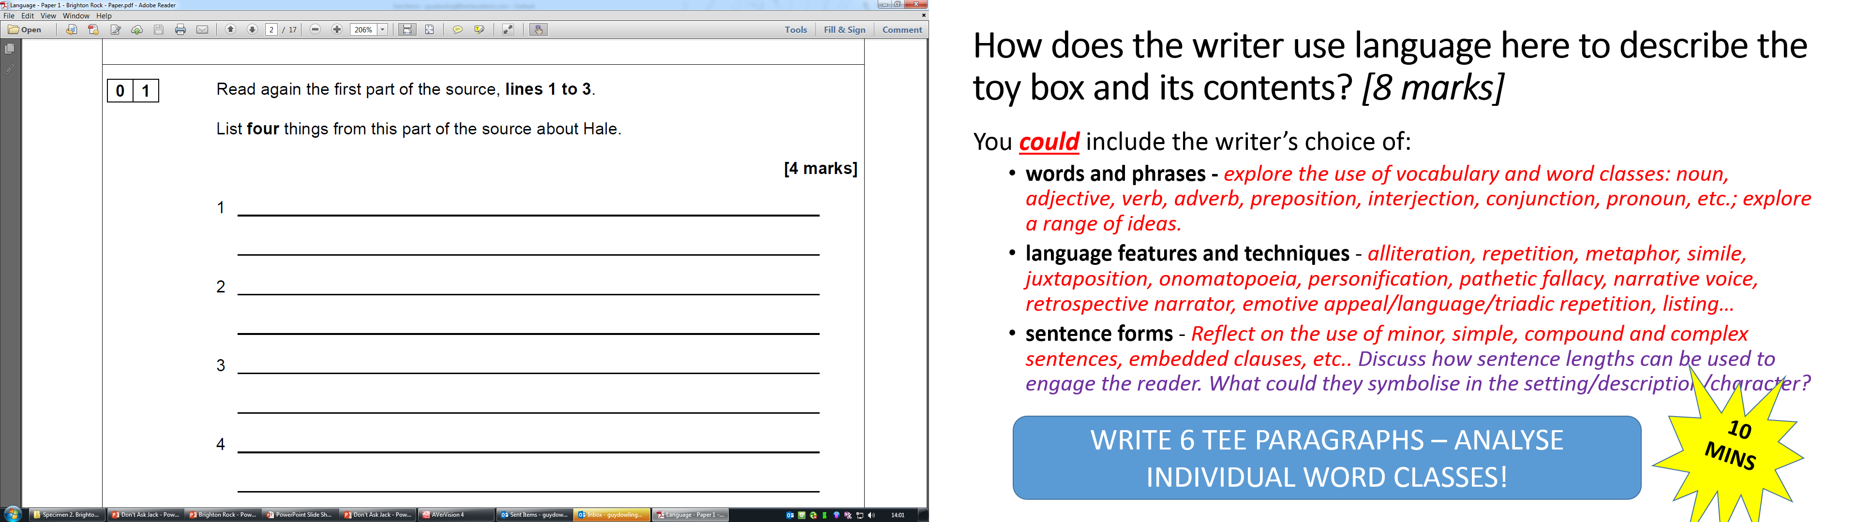

Slide 7
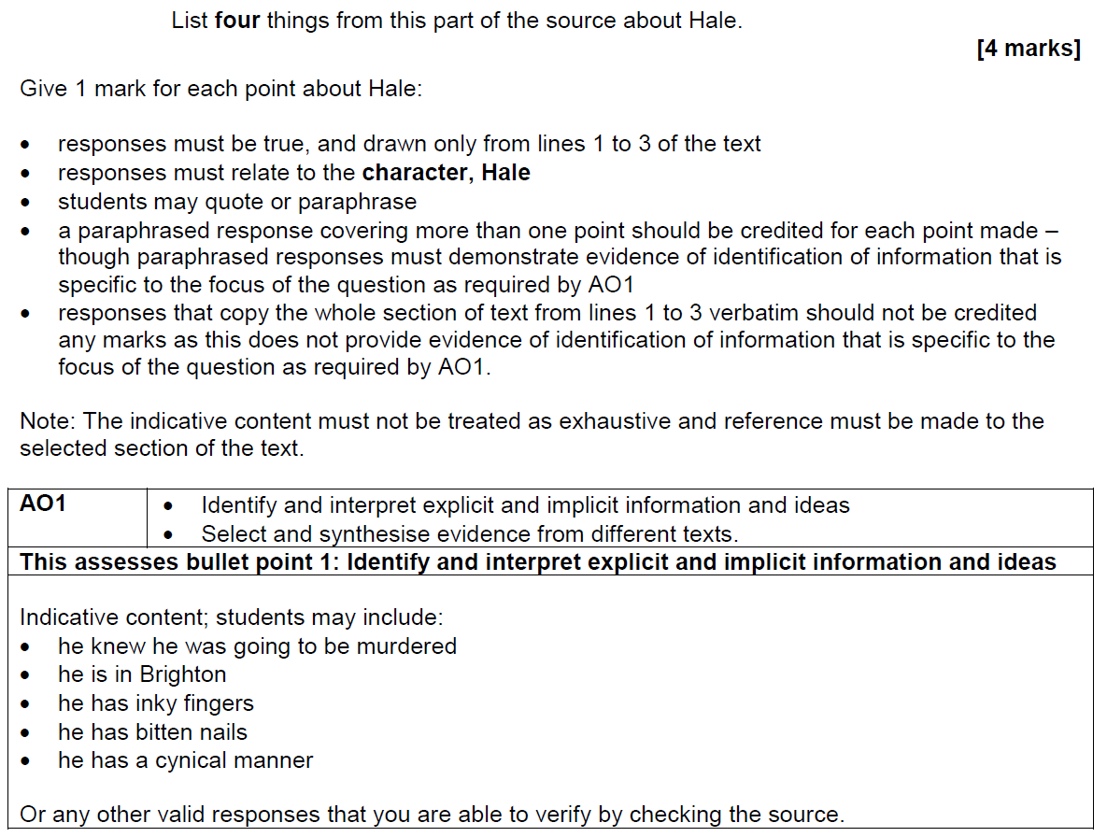

Slide 8
Question 2: 8 marks – 10 minutes
AO2 | Explain, comment on and analyse how writers use language to achieve effects and influence readers, using relevant subject terminology to support their views.
Knowledge and Skills Required:
Words and phrases: identify and explain the effect of individual words and phrase types using word classes and grammatical subject terminology.
Language techniques and features: identify and explain the effect of a broad range of literary and language devices
Sentence forms: identify and explain the symbolic or reflective use of different sentence forms

Slide 9
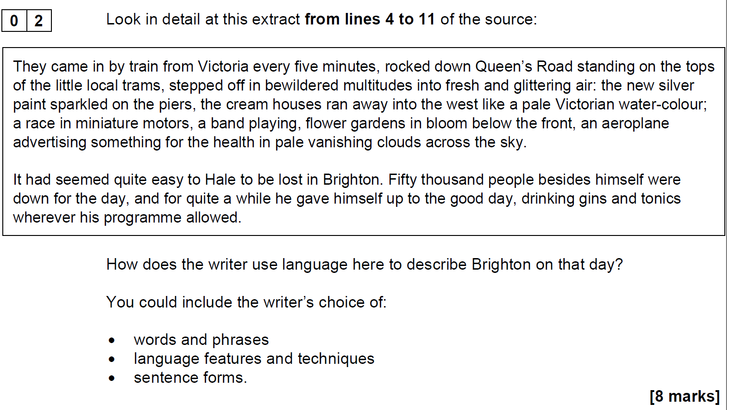

Slide 10
How does the writer use language here to describe the rat? [8 marks]
You could include the writer’s choice of:
  words and phrases - explore the use of vocabulary and word classes: noun, adjective, verb, adverb, preposition, interjection, conjunction, pronoun, etc.; explore a range of ideas.
  language features and techniques - alliteration, repetition, metaphor, simile, juxtaposition, onomatopoeia, personification, pathetic fallacy, narrative voice, retrospective narrator, emotive appeal/language/triadic repetition, listing…
  sentence forms - Reflect on the use of minor, simple, compound and complex sentences, embedded clauses, etc.. Discuss how sentence lengths can be used to engage the reader. What could they symbolise in the setting/description/character?
10 MINS
WRITE 6 TEE PARAGRAPHS – ANALYSE INDIVIDUAL WORD CLASSES!

Slide 11
Question 2 - Sentence Starters
Word Classes, Phrases, Grammar
The word __________ suggests………….
The adjective __________ suggests
The noun _______ suggests…
The verb ________ suggests…
The adverb ________ suggests…
The adjective(s) __________________ suggests…
The phrase __________________ suggests….
The noun phrase ____________________ implies…
The verb phrase _________________ implies…
The preposition ________________ suggests…………………….
The interjection _____________________ suggests…………………..
The conjunction _________________ suggests………………………
The repetitive use of the conjunction “for/and/nor/but/or/yet/so” could symbolise…
The writer’s use of the pronoun _____________________ suggests……………………..
The collective pronoun _________________ suggests………………………………..
The informal phrasing of ___________ suggests…………………
The colloquial use of ___________ suggests………………
The formal phrasing ________ is used to indicate…
The writer’s use of the adjectives ____ ________ ________ suggest…
The first person address ____ is used…
The second person direct address “You”/”Yourself” is used…
The speech is punctuated with semi-colons/exclamation points/question points…
The use of ellipsis indicates…
The serialised comma…
Such language use helps us sympathise/empathise/side/dislike ___________
Language Features and Techniques
The simile ________________ suggests………………..
The metaphor _________________ symbolises …………………….
The alliteration ______________________ suggests……………………………
The personification of _________________________ suggests………………
The oxymoron _____________________________ mirrors……………………………………..
The figurative phrase ______________ explores…………..
The ______ imagery in ____________________ suggests………………………….
The internal rhyme __________________ ……………………………
The rhetorical question _____________________ suggests…………………….
The rhetorical device ____________________ suggests…………………….
The use of anaphora _____________________ reflects………………………………
The pun _________________ suggests………………
The malapropism ________________________ suggests…………………………
The use of pathetic fallacy in ______________________ suggests…………………………..
The euphemism _______________________________ suggests……………………..
The analogy of _____________________________ is used……………………… to replicate…
The onomatopoeic __________________ conveys a sense of………….
___________ is a motif that underpins…………………………
___________ is a bildungsroman that documents ________________ in their emotional journey……………………
The hyperbolic phrase ______________________ suggests…………………………..
The metonym ___________ symbolises…
The description of ______
The authentic direct speech of ________
The use of listing here suggests….
The dramatic narrative/emotive anecdote….
The repetition of …. Suggests…
The symbolic nature of the …
Sentence Forms.
The (over/singular) use of the simple sentence(s) ___________________________ here suggests…………..
The (over/singular) use of the complex sentence(s) _______________________________ suggests…………………….
The use of the compound sentence _________________ suggests…………………………………
The use of the compound-complex/complex-compound sentence _______________________ suggests……………
The use of minor sentences such as ______ suggests………
The repetitive use of ___________ sentence forms suggests…
The mixture/sporadic use of sentence forms suggests………………..
The interrogative _____________________ suggests……………………..
The declarative ______________________ suggests………………………………
The imperative ________________________ suggests……………………………….
The exclamative _________________________ suggests……………………………
Write 6 TEE paragraphs. Use two sentence starters from each sub-heading.

Slide 12
QUESTION 2: AO2 – Language - Criteria
Level | Skill Descriptors
This question assesses Language ie: Words / Phrases / Language Features / Language Techniques / Sentence Forms
Level 4 Perceptive, detailed 7-8 marks | Shows detailed and perceptive understanding of language: Analyses the effects of the writer’s choices of language Selects a judicious range of textual detail Makes sophisticated and accurate use of subject terminology
Level 3 Clear, relevant 5-6 marks | Shows clear understanding of language: Explains clearly the effects of the writer’s choices of language Selects a range of relevant textual detail Makes clear and accurate use of subject terminology
Level 2 Some, attempts 3-4 marks | Shows some understanding of language: Attempts to comment on the effect of language Selects some appropriate textual detail Makes some use of subject terminology, mainly appropriately
Level 1 Simple, limited 1-2 marks | Shows simple awareness of language: Offers simple comment on the effect of language Selects simple references or textual details Makes simple use of subject terminology, not always appropriately
Level 0 No marks | No comments offered on the use of language. Nothing to reward

Slide 13
Words, Phrases and Grammar | Language Features and Techniques | Sentence Forms
Noun | Simile | Minor
Noun phrase | Metaphor | Simple
Concrete noun | Personification | Compound
Abstract noun | Repetition | Complex
Proper noun | Alliteration | Complex-compound
Common noun | Hyperbole | Fractured
Adjective | Pathetic Fallacy | Broken
Verb | Anthropomorphism | Incomplete
Past tense verbs | Zoomorphism | Interrogative
Present tense verbs | Anaphora | Declarative
Future form verbs | Epistrophe | Imperative
Present participle | Oxymoron | Exclamative
Past participle | Rhetorical Question | Comma splice
Gerund | Figurative | Fused/Run-on
Adverb(ial) | Metaphorical
Interjection | Allegorical
Pronoun | Allusion
Preposition | Sibilance
Conjunction | Assonance
Filler | Consonance
Hesitation | Ellipsis
Dialect | Irony
Phonetic | Direct Address
Accent | Assertion
Semantic field | [Adjective] Imagery
Lexical field | Symbolic nature
Verbing
Quantifier
Modifier
Determiner
Subordinate(ing)

Slide 14
SUBJECT TERMINOLOGY
-
How many of these key words can you spot in your partner’s work?
Words, Phrases and Grammar | Language Features and Techniques | Sentence Forms
Noun | Simile | Minor
Noun phrase | Metaphor | Simple
Concrete noun | Personification | Compound
Abstract noun | Repetition | Complex
Proper noun | Alliteration | Complex-compound
Common noun | Hyperbole | Fractured
Adjective | Pathetic Fallacy | Broken
Verb | Anthropomorphism | Incomplete
Past tense verbs | Zoomorphism | Interrogative
Present tense verbs | Anaphora | Declarative
Future form verbs | Epistrophe | Imperative
Present participle | Oxymoron | Exclamative
Past participle | Rhetorical Question | Comma splice
Gerund | Figurative | Fused/Run-on
Adverb(ial) | Metaphorical
Interjection | Allegorical
Pronoun | Allusion
Preposition | Sibilance
Conjunction | Assonance
Filler | Consonance
Hesitation | Ellipsis
Dialect | Irony
Phonetic | Direct Address
Accent | Assertion
Semantic field | [Adjective] Imagery
Lexical field
Verbing
Quantifier
Modifier
Determiner
Subordinate(ing)
EXTENSION
-
Set your partner targets on which columns they need to work on identifying.

Slide 15
Level ?
The writer says that ‘Fifty thousand people besides himself were down for the day’. The words ‘fifty thousand’ emphasise that it was very crowded on that day and that Hale was just one of them.

Slide 16
Level ?
The words ‘every five minutes’ emphasises how often the crowd arrived on that day and shows how busy it would have been in Brighton. The verb ‘rocked’ suggests that the ‘little trams’ were so crowded they were swaying from side to side. When they got off the trams, the crowd were ‘bewildered’ because they weren’t sure where they were in Brighton so it makes us feel sorry for them.

Slide 17
Level ?
The opening complex sentence includes a list of what the crowd experienced as they arrived in Brighton. The writer uses the noun ‘multitudes’ to suggest that there are thousands of visitors, packed together, and the verb ‘rocked’ gives the idea that they were swaying from side to side on the tops of the ‘little trams’, making the reader think that it was a bit dangerous. This is relieved with the description, ‘fresh and glittering air’, which sounds healthy and exciting – just what the crowd have come to Brighton for.

Slide 18
Level ?
The first paragraph consists of a single complex sentence which rolls out a list of sights, perhaps suggesting the onward movement of the crowd on the tram as they make their way into Brighton. The idea that, for the crowd, this is a pilgrimage, is suggested by the biblical noun, ‘multitudes’ and that their ‘bewilderment’ is partly due to their disorientation at seeing the sights of Brighton set out before them – their paradise for the day.

Slide 19
Self-Assessment – Give yourself a mark out of 8
Level | Skill Descriptors
This question assesses Language ie: Words / Phrases / Language Features / Language Techniques / Sentence Forms
Level 4 Perceptive, detailed 7-8 marks | Shows detailed and perceptive understanding of language Analyses the effects of the writer’s choices of language Selects a range of judicious quotations Uses sophisticated subject terminology accurately
Level 3 Clear, relevant 5-6 marks | Shows clear understanding of language Clearly explains the effects of the writer’s choices of language Selects a range of relevant quotations Uses subject terminology accurately
Level 2 Some, attempts 3-4 marks | Shows some understanding of language Attempts to comment on the effect of language Selects some relevant quotations Uses some subject terminology, not always appropriately
Level 1 Simple, limited 1-2 marks | Shows simple awareness of language Offers simple comment on the effect of language Simple references or textual details Simple mention of subject terminology
Level 0 No marks | No comments offered on the use of language. Nothing to reward
EXTENSION
TECHNIQUE COUNT: make a note of how many techniques you explained.
QUOTE COUNT: make a note of how many quotes you used.
BULLET MATCH: label each technique with which bullet point it matches. You should have two of each.

Slide 20
Question 3: 8 marks – 10 minutes
AO2 | Explain, comment on and analyse how writers use language and structure to achieve effects and influence readers, using relevant subject terminology to support their views.
Knowledge and Skills Required:
Ability to read through the whole of the text and annotate throughout
Distinguish where the writer shifts narrative perspective or focus within the text
Identify and explain where and how a writer changes setting, develops character or uses dialogue for a specific effect.
Pick out repetition of a key theme, sentence, word or motif and explain its significance or importance
Give an overview of the journey the reader has been on throughout the text.
Comment on the moral/meaning on the text and how this has been structured.

Slide 21
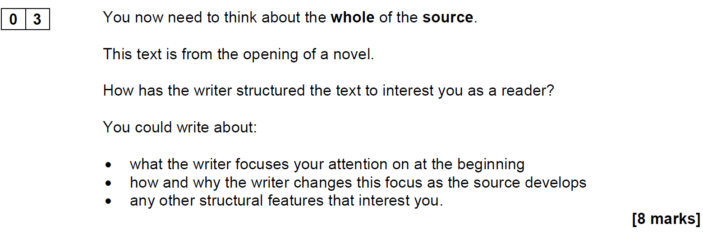

Slide 22
Question 3 will always focus on the structural features of the whole text:
  the sequence through a passage, such as: introduction, development, summary and conclusion, repetition, threads, patterns or motifs
  shifts in ideas and perspectives, such as: movement from big to small, place to place, outside to inside (and vice versa), narrative perspectives
  coherence, such as: connections and links across paragraphs, links within paragraphs, topic sentences.

Slide 23
When analysing structure, consider these first:
Setting | How do we know when and where the narrative is set? Are we outside or inside a building?
Narrative | Is it a first- or a third-person narrator?
Character | How is the main character introduced? Do we meet him/her immediately, or is he or she introduced later?
Atmosphere | Is the atmosphere light or dark? Does it change during the passage?
Events | What happens in the first few pages? How do the events engage the reader?

Slide 24
Close analysis and how to comment on structure
Term | Definition | Sentence starter
Focusing | Where the writer points the attention of the reader. This changes throughout the passage. | The first paragraph focuses on…
Introducing | When a character or idea is first mentioned. | The main character … is introduced as a ….
Developing | As we are given more information, we learn more about a character or situation. | At first we think of [character] as being ….., but as …………. develops we……….
Changing | A writer will change the focus throughout the course of the opening by introducing a new character or event. | When [other character] appears, the focus changes. … is seen through the eyes of a child (for example)
Concluding | Where the examiner has chosen to end the extract will usually indicate a kind of conclusion. | [main character’s] concluding speech tells us that…

Slide 25
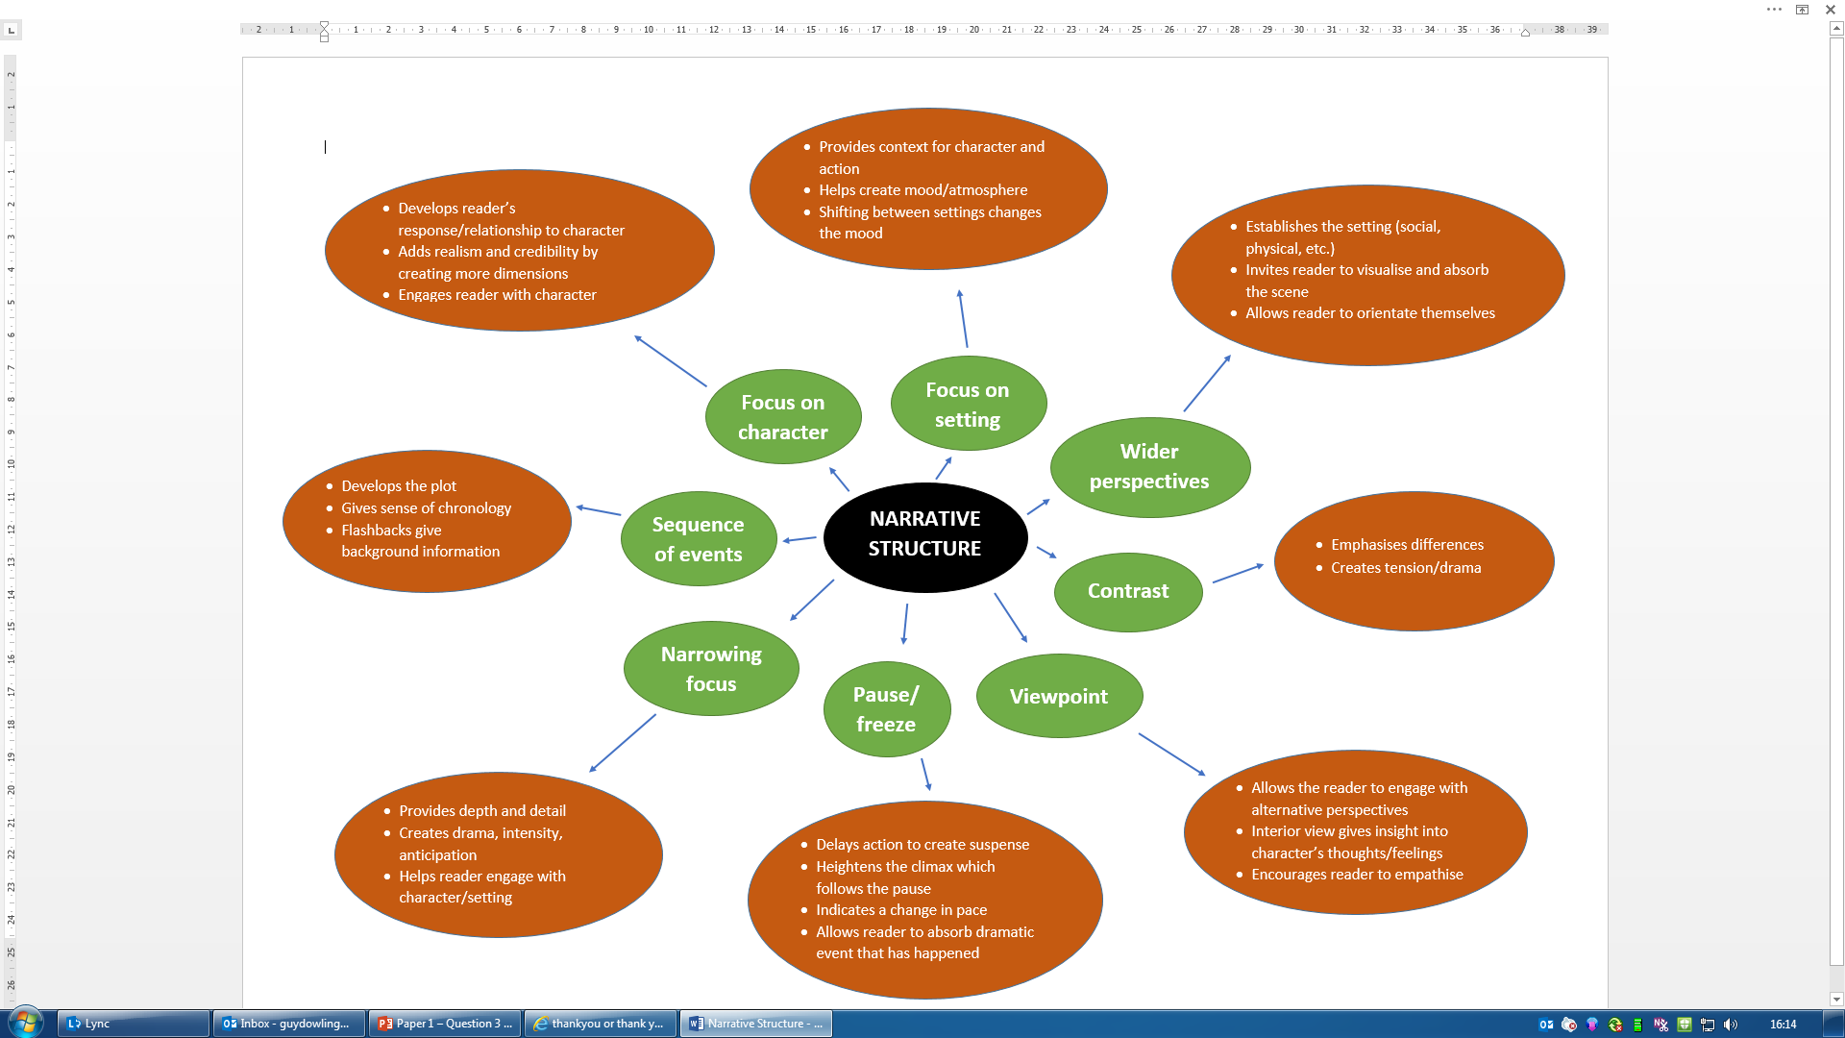

Slide 26
Question 3 – AO2 - Structure
This question assesses how the writer has structured a text. Structural features can be: at a whole text level e.g. beginnings / endings / perspective shifts; at a paragraph level e.g. topic change / aspects of cohesion; and at a sentence level when judged to contribute to whole structure
Level | Skill Descriptor
Level 4 Perceptive, detailed 7-8 marks | Shows detailed and perceptive understanding of structural features: Analyses the effects of the writer’s choice of structural features Selects a judicious range of examples Makes sophisticated and accurate use of subject terminology
Level 3 Clear, relevant 5-6 marks | Shows clear understanding of structural features: Explains clearly the effects of the writer’s choice of structural features Selects a range of relevant examples Makes clear and accurate use of subject terminology
Level 2 Some, attempts 3-4 marks | Shows some understanding of structural features: Attempts to comment on the effect of structural features Selects some appropriate examples Makes some use of subject terminology, mainly appropriately
Level 1 Simple, limited 1-2 marks | Shows simple awareness of structure: Offers simple comment on the effect of structure Selects simple references or examples Makes simple use of subject terminology, not always appropriately
Level 0 No marks | No comments offered on the use of structure Nothing to reward
AO2 content may include the effect of ideas such as:
the overall structure of a journey – moving through place
the change of structural focus from outside to inside
the consistent reminder of the weather, recapitulated through the text
narrowing down the focus to the individual characters.

Slide 27
Structure Question – Structure of Answer
Overview or how the text is built and the journey the reader is taken on – shifts in narrative perspective – builds mystery – ends with cliff-hanger
3 SEE paragraphs
  S = Structural Device/Feature
  E = Evidence
  E = Effect of structural device/feature on reader
    Why has the device been used?
    What has the reader learnt from this?
    How has the narrative progressed or been affected?
    How does the reader now engage emotionally to the characters, action or narrative because of this?
Summary of structural effects and how the text has ended

Slide 28
Level ?
The text tells us about Hale, and so introduces us to the main character. The writer then moves on to the crowd and the reader can follow what happens during that day in Brighton.

Slide 29
Level ?
The writer introduces Hale in the first paragraph so that the reader has a clear idea of the main person in the story and what he is like. It then moves on to the crowd in Brighton and follows through, in chronological order, some of the places Kolly Kibber goes, and explains to the reader what he is doing.
So the story widens out but keeps Hale in the centre of the action by following him through that day.

Slide 30
Level ?
The writer begins with a focus on one person – Hale, the main character, his feelings and what he is like, so that the reader can identify with him. Then the scene widens out to the ‘multitudes’ of the crowd and to the streets of Brighton. Then these elements come together as the reader understands Hale’s job as ‘Kolly Kibber’ and that he is trying to use the crowd and the places to avoid his fate. As the extract develops, it narrows down again to Hale’s thoughts and puts the crowd at a distance from him – so he ends up alone, like he was at the beginning.

Slide 31
Level ?
The text is structured so that the reader can experience the relationship between the one man – Hale, and Brighton and its multitudes, on that day. They start separately but then converge as he joins the crowds to do his job as Kolly Kibber. The reader is taken on a journey which starts inside Hale’s thoughts, then widens through the geography of Brighton and the other places where he does his job, then narrows to his singular act of drinking gin and tonic, then moves back to the outside and the crowd. Towards the end, Hale and the crowd face each other in the same space as he leans against the rail of the Palace Pier, and the journey stops. Time is also a structural feature of the text because we are reminded of it throughout. At the end, we return to the singular Hale, alone, as he moves off on his journey again – but the reader knows he’s no further away from being murdered than he was on the first line. So the journey ends where it began.

Slide 32
Question 4 – 20 marks – 20 minutes
AO4 | Evaluate texts critically and support this with appropriate textual references.

Slide 33
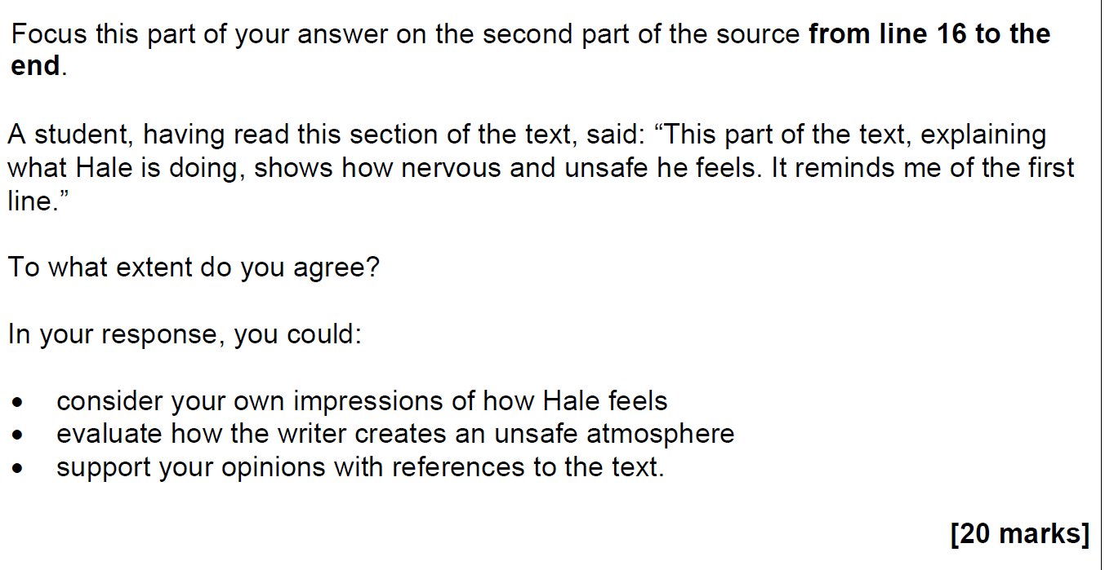

Slide 34
QUESTION 4: AO4 - Evaluate texts critically
Level | Overview Statement | Skill Descriptors
Level 4 Perceptive, detailed 16-20 marks | In this level critical evaluation will be perceptive and detailed | Evaluates critically and in detail the effect(s) on the reader Shows perceptive understanding of writer’s methods Selects a judicious range of textual detail Develops a convincing and critical response to the focus of the statement
Level 3 Clear, relevant 11-15 marks | In this level critical evaluation will be clear and consistent | Evaluates clearly the effect(s) on the reader Shows clear understanding of writer’s methods Selects a range of relevant textual references Makes a clear and relevant response to the focus of the
Level 2 Some, attempts 6-10 marks | In this level there will be some evaluative comments | Makes some evaluative comment(s) on effect(s) on the reader Shows some understanding of writer’s methods Selects some appropriate textual reference(s) Makes some response to the focus of the statement
Level 1 Simple, limited 1-5 marks | In this level there will be simple personal comment | Makes simple, limited evaluative comment(s) on effect(s) on reader Shows limited understanding of writer’s methods Selects simple, limited textual reference(s) Makes a simple, limited response to the focus of the statement
Level 0 No marks | No relevant comments offered in response to the statement, no impressions, no evaluation.

Slide 35
Question 4 – Answer Structure
Respond to reviewer and acknowledge the extent of your agreement.
  E.g. I don’t entirely agree with the reviewer because…
6-8 PETER paragraphs
  Point/Opinion
  Evidence
  Technique – word class/language feature/technique/sentence form or structure
  Explanation
  Reader
End with overall judgement/summary/rhetorical question that probes the text further.

Slide 36
Level ?
Level
Level 4 Perceptive, detailed 16-20 marks
Level 3 Clear, relevant 11-15 marks
Level 2 Some, attempts 6-10 marks
Level 1 Simple, limited 1-5 marks
Level 0 No marks
I agree with the student in that I also feel that the writer is asking me to think about the significance of the opening line, that ‘they meant to murder him’ by focussing my attention at the end of the extract on his ‘bitten nails and inky fingers’. In this way, I feel the writer is successful in conveying Hale’s nervousness to the reader. Hale’s feelings about his situation in the crowd are ambivalent. An atmosphere of fear and tension is created because, ironically, his loyalty to The Messenger makes him do his duty amongst the crowd, yet somebody in the crowd – he knows – is going to kill him. The writer creates a further irony because, to do his ‘duty’, Hale has to wear the same hat he has on in the paper’s photograph and be at precise places at precise times – in so doing, he comes conspicuous for his killer. A further irony is the use of various forms of the word ‘challenge’ – the ‘big prize’ will, in fact, be for the murderer who carries out the challenge on Hale’s life. His feelings for the crowd are also ambivalent and show his unease. He feels he must be fair to them, but also describes them, cynically, as uncoiling ‘like a twisted piece of wire’. So I ask myself as a reader, why is the writer contrasting the fun of the seafront with the sinister possibility of Hale’s murder?

Slide 37
Level ?
Level
Level 4 Perceptive, detailed 16-20 marks
Level 3 Clear, relevant 11-15 marks
Level 2 Some, attempts 6-10 marks
Level 1 Simple, limited 1-5 marks
Level 0 No marks
I agree with the statement. I’m not sure why the writer emphasizes Hale’s nervousness when everyone else is having fun around him. It helps me to wonder whether what is said in the first line will happen. Hale seems to be torn between wanting to be in the crowd, to do ‘his duty’ and because there is safety in numbers, and the knowledge that somebody in the crowd is going to kill him. This dilemma creates a tense and nervous atmosphere which is reinforced by the writer’s use of the words like ‘hastily’ to describe Hale’s actions, and ‘a clock struck eleven’ indicating that maybe he is running out of time. The repetition of the word ‘challenge’ in various forms also has an uneasy, double meaning – an innocent challenged by somebody for Hale’s life.

Slide 38
Level ?
Level
Level 4 Perceptive, detailed 16-20 marks
Level 3 Clear, relevant 11-15 marks
Level 2 Some, attempts 6-10 marks
Level 1 Simple, limited 1-5 marks
Level 0 No marks
It’s a good opening to a novel, I agree. It didn’t make me think when I read it too much about the opening line but I can see that Hale is nervous. I think Hale stays with the crowd because he feels he has to do his job properly but also because maybe he’s nervous and thinks he’ll be safer. But the writer creates a tense atmosphere by saying that even in the crowd, ‘there were reasons why he didn’t feel safe’ – that someone is out to kill him.

Slide 39
Level ?
Yes I agree. I think that Hale is nervous and worried because the writer makes it clear that ‘he didn’t feel too safe in Brighton, even in a Whitsun crowd’, and in the beginning it says he knew somebody was going to murder him. Being in the crowd doesn’t seem to help.
Level
Level 4 Perceptive, detailed 16-20 marks
Level 3 Clear, relevant 11-15 marks
Level 2 Some, attempts 6-10 marks
Level 1 Simple, limited 1-5 marks
Level 0 No marks

Slide 40
Section B: Writing
45 minutes
Question 5
Narrative or Descriptive Writing

Slide 41
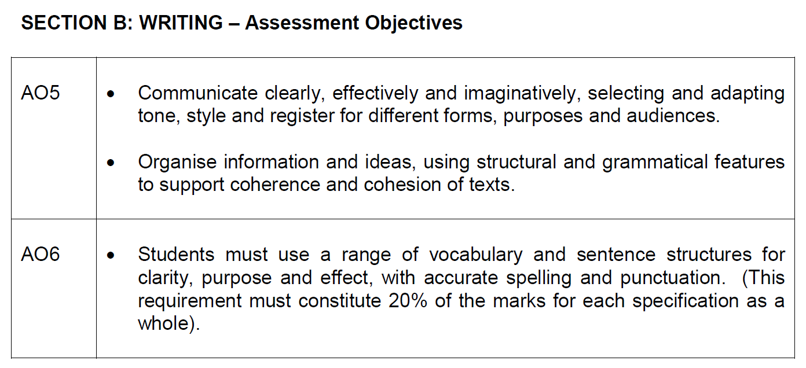

Slide 42
Either: Describe an occasion when you felt unsure or challenged. Focus on the thoughts and feelings you had at that time.
Or: Write a description suggested by this picture:
(24 marks for content and organisation
16 marks for technical accuracy)
[40 marks]

Slide 43
Content and Organisation
Content and Organisation – 24 marks
Level 4 | Content – convincing and crafted
 | Organisation – structured, developed, complex, varied
Level 3 | Content – clear, chosen for effect
 | Organisation – engaging, connected
Level 2 | Content – mostly successful and some control
 | Organisation – linked/relevant, paragraphed
Level 1 | Content – simple
 | Organisation – simple, limited

Slide 44
Technical Accuracy
AO6 - Technical Accuracy - Assess my…
 | Skills
Level 4 “Consistent, high level, full range” | Sentence demarcation – consistently secure and consistently accurate
 | Punctuation – high level of accuracy
 | Sentence forms – full range used for effect
 | Standard English – consistent and controlled
 | Spelling – high level of accuracy
 | Vocabulary – extensive and ambitious
Level 3 “mostly, range, varied” | Sentence demarcation – mostly secure and mostly accurate
 | Punctuation – a range used, mostly successful
 | Sentence forms – a variety used for effect
 | Standard English – mostly used and controlled
 | Spelling – generally accurate
 | Vocabulary – increasingly sophisticated
Level 2 “some attempts” | Sentence demarcation – mostly secure and sometimes accurate
 | Punctuation – some control of range
 | Sentence forms – attempts a variety
 | Standard English – some use
 | Spelling – some accurate
 | Vocabulary – varied
Level 1 “Simple, occasional” | Sentence demarcation – occasional
 | Punctuation – some evidence
 | Sentence forms – simple range
 | Standard English – occasional
 | Spelling – accurate basic spelling
 | Vocabulary – simple

